Slide 1
SRU
SR UNIVERSITY | CSE [AIML] | BATCH 9
JobSpace
A Unified Job Application Intelligence Platform
TEAM MEMBERS
2303A52325 Kandagatla Sai Teja
2303A52330 Bandi Rithwik
2303A52352 Elikatte Tharun
2303A52356 Kumba Ganesh
Node.js
Express.js 5
MongoDB Atlas
React
Vercel
Render
JWT
Mongoose
6
9
5
3
6
Modules
API Routes
DB Models
Cloud Services
Analytics Pipelines
April 2026

Slide 2
02
The Problem
Understanding the challenges in modern job search management chaos
2 / 14

Slide 3




PROBLEM STATEMENT
Problem in Modern Job Search
The modern job search process is fragmented, unstructured, and lacks analytical support, making it difficult for candidates to effectively manage and optimize their application lifecycle.
No Structure
Zero Analytics
Missing Tools
Job seekers juggle applications across spreadsheets, emails, and sticky notes.
No way to measure response rates, track patterns, or optimise the search.
Existing platforms (Huntr, Teal) lack custom columns, CRM, and document management.
Missed follow-ups
Duplicate apps
No funnel data
No velocity tracking
Fixed schemas
No document vault
No status tracking
Blind decision-making
No company CRM
JobSpace solves this — one platform for tracking, analytics, CRM, and documents.
3 / 14

Slide 4






OBJECTIVES
What We Set Out to Build
Develop a Multi-Tenant, Full-Stack platform for managing the complete Job Application lifecycle
Implement Dual-Mode authentication (JWT + session) for secure cross-Domain use
Design a Dynamic Column engine enabling user-defined schema customization without database migrations
Develop an analytics engine using MongoDB aggregation pipelines for multi-dimensional insights
Create a Company CRM module to manage recruiter interactions and application status lifecycle
Deploy the System on scalable cloud infrastructure using Vercel, Render, and MongoDB Atlas
4 / 14

Slide 5


STAKEHOLDERS
Who Uses JobSpace?
JobSpace Supports Multiple Stakeholder groups, Each Interacting with the system at different levels of Access a nd Functionality.
Job Seekers
Platform Admins
Recruiter Entities (Stored Data)
Track and manage large volumes of job applications efficiently
Custom column types per workflow
Measure response & offer rates
Store resume versions safely
Manage users using role-based access control (RBAC)
View system-wide statistics and usage insights
Assign and revoke user roles
Monitor system activity and platform performance
Stored as Company CRM records within the system
Recruiter details (name, email, LinkedIn) maintained
Application status tracked across lifecycle stages
Interaction history recorded via notes and contact fields
5 / 14

Slide 6


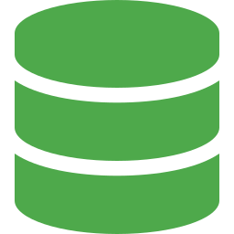







TECHNOLOGY STACK
Tools & Technologies
The system is built using a modern MERN stack architecture with supporting tools for development, deployment, and data management.
Backend
Frontend
Database
Deployment
Dev Tools
Node.js 20 LTS
React + Vite
MongoDB Atlas
Render (API)
Git / GitHub
Express.js 5
SPA (single-page)
Mongoose 9 ODM
Vercel (SPA)
VS Code
Session-based Auth + bcryptjs
Dynamic grid UI
connect-mongo
Atlas (DB)
AI-assisted development tools
Multer (uploads)
6 / 14

Slide 7

AI-ASSISTED DEVELOPMENT
Prompts That Built JobSpace
How we used AI to accelerate development — prompt → output → integrated into the system
PROMPT
“Generate a production-ready full-stack SaaS Job Tracking system (JobSpace) using Node.js, Express, MongoDB, and modern UI principles, including authentication, dashboards, analytics, document management, and admin features.”
Output: Generated complete project structure with backend, frontend, models, routes, controllers, and UI components.
Used in: Initial system architecture and full project foundation (backend + frontend mo
PROMPT
"Configure Express CORS to securely handle cross-origin requests, including support for dynamic frontend URLs such as Vercel deployments and development environments."
Output: Implemented dynamic CORS configuration with origin validation and secure request handling
Used in: Backend server configuration to enable secure communication between frontend and API
PROMPT
"Design a dynamic update handler that routes incoming fields to either predefined Mongoose schema fields or a flexible extraData structure using MongoDB dot notation for scalable schema-less storage."
Output: Implemented dynamic PATCH dispatcher enabling flexible field mapping and atomic updates using MongoDB operations
Used in: Core backend logic enabling customizable spreadsheet columns without requiring database schema modifications
7 / 14

Slide 8
AI-ASSISTED DEVELOPMENT
More Prompts — Analytics & Security
PROMPT
“Design a scalable analytics controller using MongoDB aggregation pipelines to compute monthly trends, status distribution, response rates, and top companies.”
Output: analyticsController.js – multi pipeline aggregation, optimized queries, KPI – ready datasets
Used in: Analytics dashboard — enables charts, trends, and decision-making insights
PROMPT
"Configure Express CORS with both exact origin matching and wildcard regex pattern support for Vercel preview deployment URLs"
Output: Dynamic CORS resolver – handles *.vercel.app previews safely via regex at startup
Used in: app.js CORS config – production-safe for continuous deployment workflows
PROMPT
"Design a Multer file upload middleware with disk storage, randomized filenames, file type whitelist (pdf/docx/jpg), and 10MB size cap"
Output: uploadMiddleware.js – collision-resistant names, prevents path traversal attacks
Used in: Document vault – handles resume, cover letter, portfolio, certificate uploads
8 / 14

Slide 9
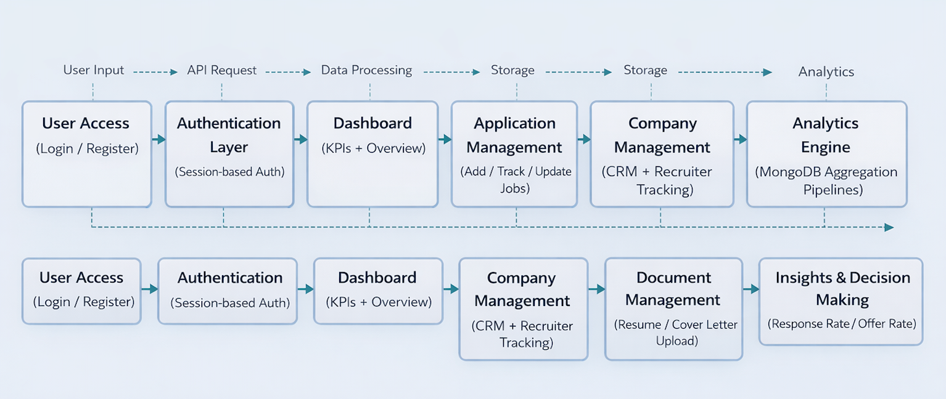
SYSTEM WORKFLOW
How JobSpace Works
[ PLACE FLOWCHART HERE ]
JobSpace Workflow: Register → Login (JWT/Session) → Add Applications → Track Status → Manage Companies → Upload Documents → View Analytics Dashboard
1
2
3
4
5
6
Register / Login
Add Application
Track & Update
Manage Companies
Upload Documents
Analytics Dashboard
JWT or Session auth
Job title, company, status
Inline edit, custom columns
CRM + recruiter info
Resume, cover letter
Charts + KPIs
9 / 14

Slide 10
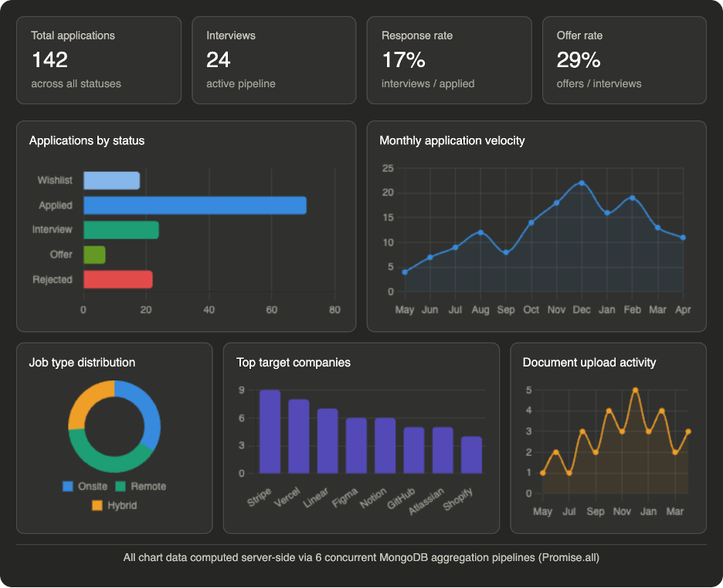
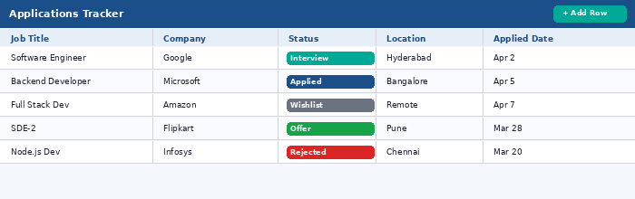
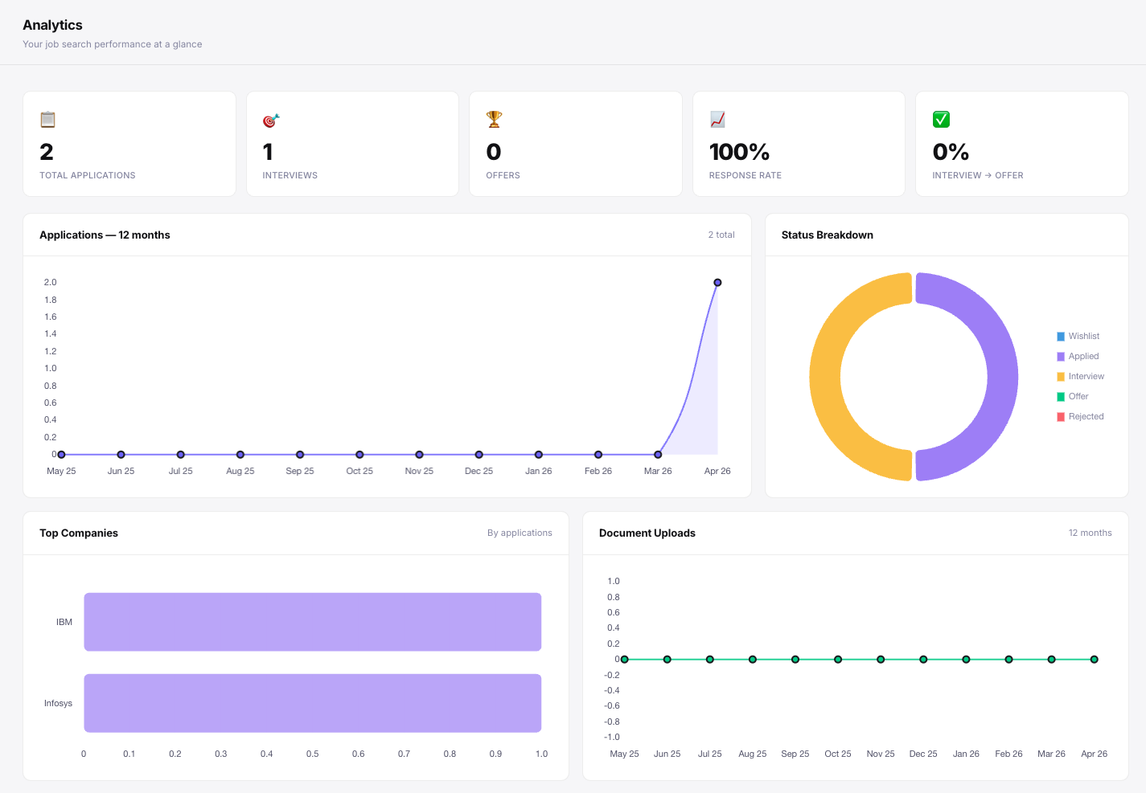

FRONTEND UI
What the User Sees
[ PLACE UI SCREENSHOT HERE ]
[ PLACE UI SCREENSHOT HERE ]
[ PLACE UI SCREENSHOT HERE ]
Dashboard
Applications
Analytics
Dashboard
Applications
Analytics
KPI cards + 6 charts
Dynamic spreadsheet grid
6-chart analytics suite
Inline cell editing with typed validation
Custom column types (text, number, date, dropdown)
Status lifecycle chips (Applied → Offer)
Company CRM module with recruiter fields
Document vault with 5 typed categories
10 / 14

Slide 11
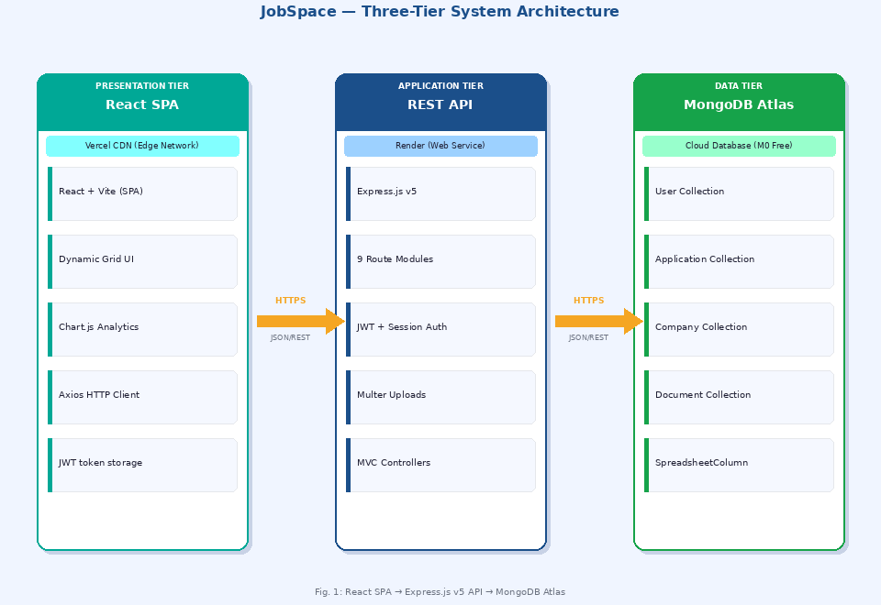
SYSTEM ARCHITECTURE
Three-Tier Architecture
[ PLACE ARCHITECTURE DIAGRAM HERE ]
Presentation Tier
React SPA
Vercel CDN
Bearer JWT
Application Tier
Express.js 5 / Render
9 route modules
Auth Middleware
Fig. 1: High-Level System Architecture
(React SPA → Express.js API → MongoDB Atlas)
Data Tier
MongoDB Atlas
5 Mongoose models
connect-mongo sessions
11 / 14

Slide 12
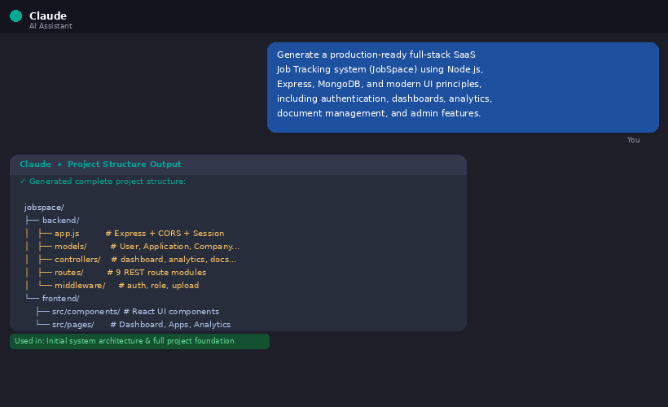
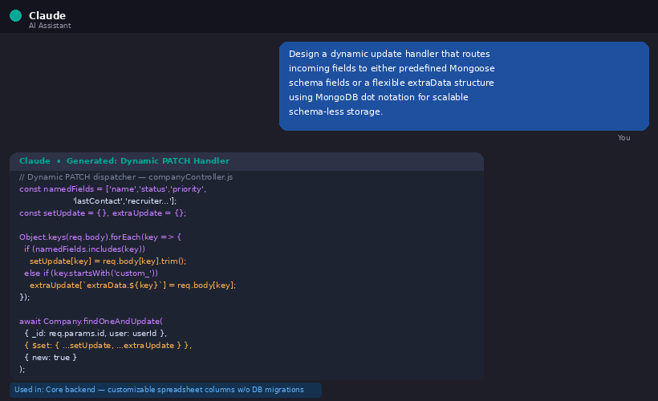
PROOF OF AI USAGE
AI-Assisted Development — Evidence
Screenshots showing how AI tools were used to generate and refine production code
[ PLACE SCREENSHOT HERE ]
[ PLACE SCREENSHOT HERE ]
AI chat showing the auth middleware prompt and generated resolveUser() function
AI generating the 6-pipeline Promise.all() aggregation controller
Prompt Input → Code Output
Analytics Pipeline Generation
AI tools used: Anthropic Claude (architecture + code generation), ChatGPT (debugging), GitHub Copilot (inline suggestions)
12 / 14

Slide 13
COMPARATIVE ANALYSIS
JobSpace vs Existing Tools
Feature
Huntr
Teal HQ
Simplify
JobSpace
Custom column types
No
No
No
✓ 4 types
Analytics pipeline
Basic
None
None
✓ 6 charts + KPIs
Company CRM
Basic
None
None
✓ Full + recruiter
Document vault
None
Basic
None
✓ Multi-type
Dual auth (JWT+Session)
No
No
No
✓ Unique hybrid
API-first architecture
No
No
No
✓ Full REST API
Open-source
No
No
No
✓ Yes
JobSpace is the only tool that delivers all 7 capabilities in a single platform.
13 / 14

Slide 14
Thank You
JobSpace — A Unified Job Application Intelligence Platform
REFERENCES
[1] Grand View Research (2024). Recruitment Technology Market Report.
[2] Breaugh, J.A. (2013). Employee recruitment. Human Resource Management Review.
[3] Fielding, R.T. (2000). REST Architecture. UC Irvine Doctoral Dissertation.
[4] OWASP Foundation (2023). Authentication & CORS Cheat Sheets.
[5] Sadalage & Fowler (2012). NoSQL Distilled. Addison-Wesley.
[6] MongoDB Docs (2024). Aggregation Pipeline. mongodb.com/docs
[7] Jones, Bradley, Sakimura (2015). JSON Web Token. RFC 7519. IETF.
JobSpace is production-deployed, open-source, and ready for real job seekers today.
Kandagatla Sai Teja • Bandi Rithwik • Elikatte Tharun • Kumba Ganesh | SR University | CSE [AIML] | Batch 9 | April 2026
14 / 14

